Slide 1
Deepfake Detection
-Sahiti Lakkoju
-21WU0101028

Slide 2
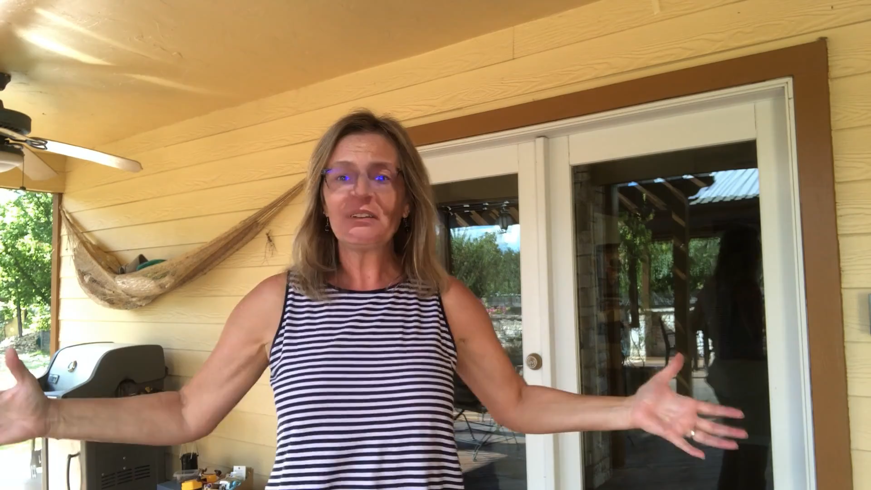
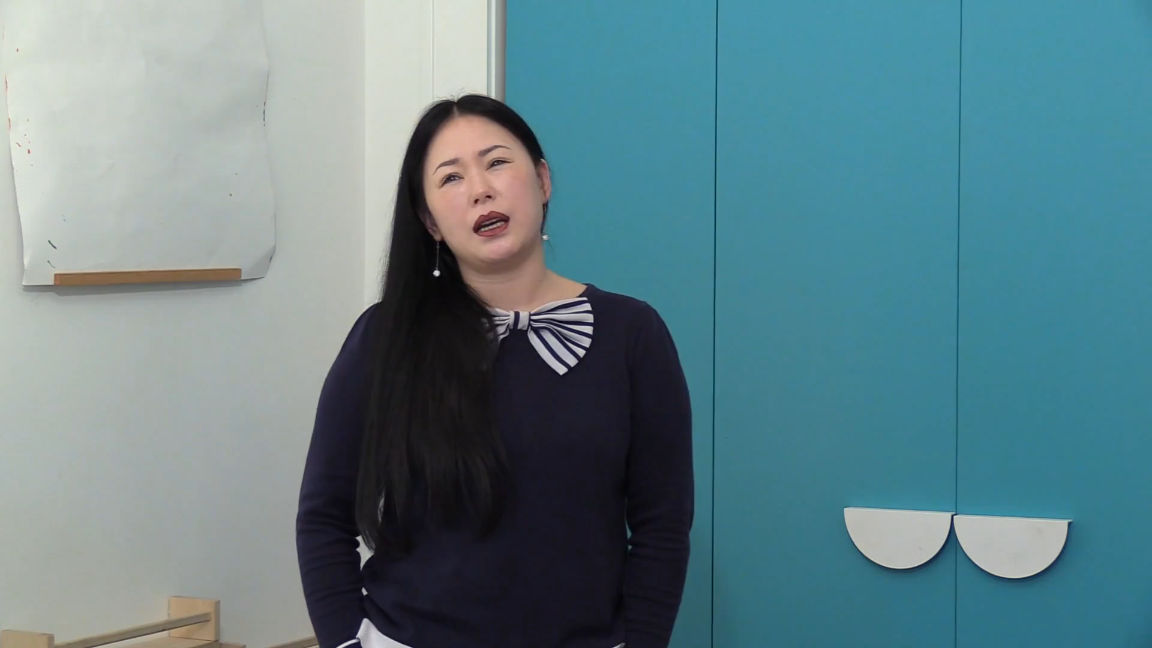
Dataset Exploration
This project involved working with the Deepfake sourced from the Kaggle domain. This dataset comprises 800 videos in the ‘.mp4' format, frames are extracted from the videos, each with dimensions of 128 x 128 pixels, distributed across 2 distinct classes.
Class: Deepfake Class: Real

Slide 3
Implementation Results:
S.no | Model Approaches | Accuracy(%) | Precision(%) | Recall(%) | F1-Score(%)
1. | CNN2D | 90% | 93.4% | 95.1% | 94.2%
2. | VGG16 | 88.48% | 92.0% | 93.8% | 92.9%

Slide 4
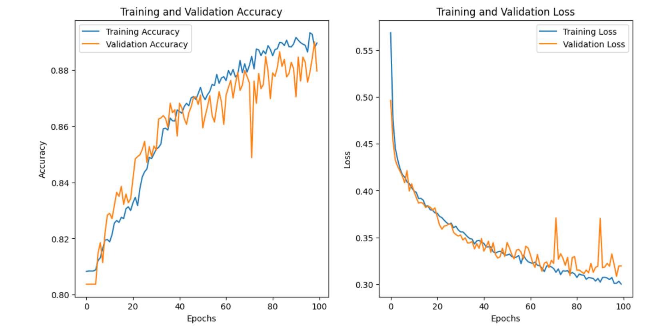
Model Accuracy Vs Loss

Slide 5
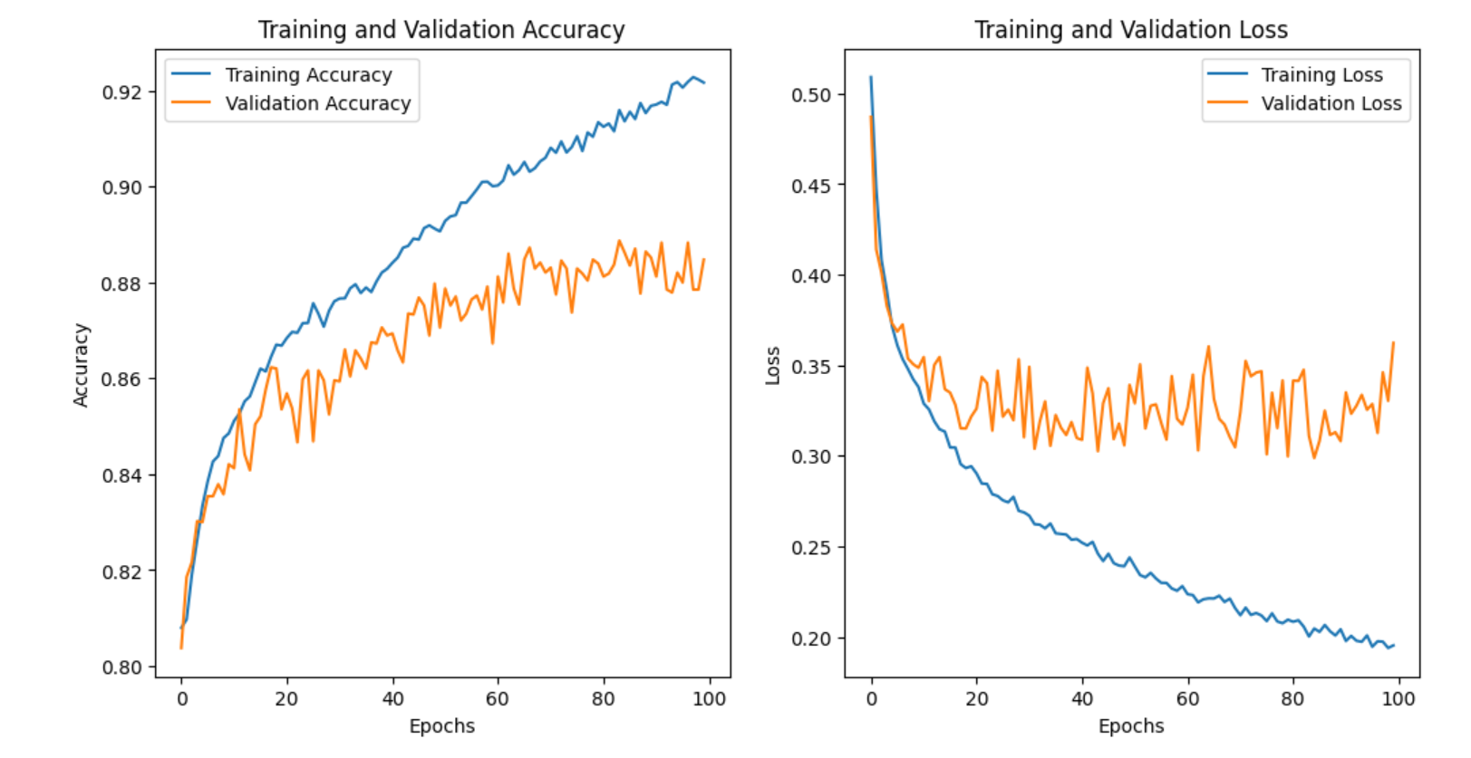

Slide 6
References:
[1] Deng, Pan., Lixian, Sun., Rui, Wang., Xingjian, Zhang., Richard, O., Sinnott. (2020). Deepfake Detection through Deep Learning. 134-143. 10.1109/BDCAT50828.2020.00001
[2] Nimitt, Patel., Niket, Jethwa., Chirag, V, Mali., Jyoti, Deone. (2022). Deepfake Video Detection using Neural Networks. ITM web of conferences, 44, 03024-03024. 10.1051/itmconf/20224403024
[3] Siwei, Lyu. (2022). DeepFake Detection. 313-331. 10.1007/978-981-16-7621-5_12
[4] Guarnera, L., Giudice, O., & Battiato, S. (2020). DeepFake Detection by Analyzing Convolutional Traces. ArXiv. /abs/2004.10448

Slide 7
[5] Dolhansky, B., Bitton, J., Pflaum, B., Lu, J., Howes, R., Wang, M. and Ferrer, C.C., 2020. The deepfake detection challenge (dfdc) dataset. arXiv preprint arXiv:2006.07397.
[6] Taeb M, Chi H. Comparison of Deepfake Detection Techniques through Deep Learning. Journal of Cybersecurity and Privacy. 2022; 2(1):89-106. https://doi.org/10.3390/jcp2010007
[7] Prasad, D. V., Harsha, M., Krishna, N. N., Sanjay, T. C., & Kiran, Y. C. (2022). Comparative study on Deepfake Detection Methods. International Journal of Advanced Research in Computer and Communication Engineering, 11(6), 606. DOI: 10.17148/IJARCCE.2022.116113.

Slide 8
Thank You

